Slide 1
Angular CLI
Angular CLI Setup and Verification
Lecture 2
By James(Jin) Wang
11/28/2021

Slide 2
Outline
Checking Requirements
Installing the Angular CLI
Verifying all is well
Key Resources

Slide 3
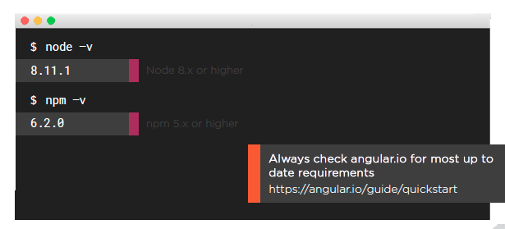
Angular CLI Requirements
  Checking Requirements:

Slide 4
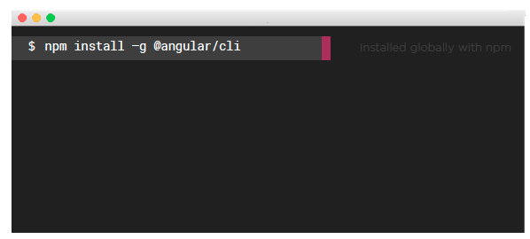
Installing the Angular CLI

Slide 5
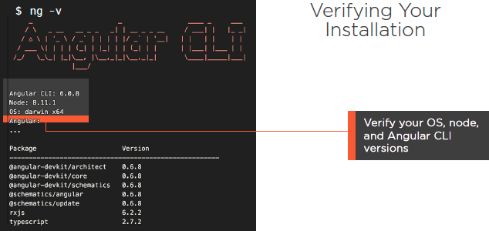
Verifying your Installation

Slide 6
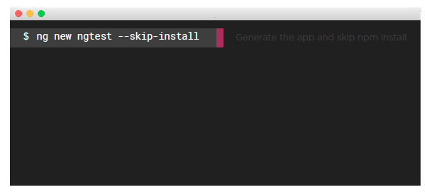
Generating and Verifying a New App

Slide 7
Generating and Verifying a New App
  npm list -g @angular/cli --depth=0
  npm new ngtest --skip-install

